Slide 1

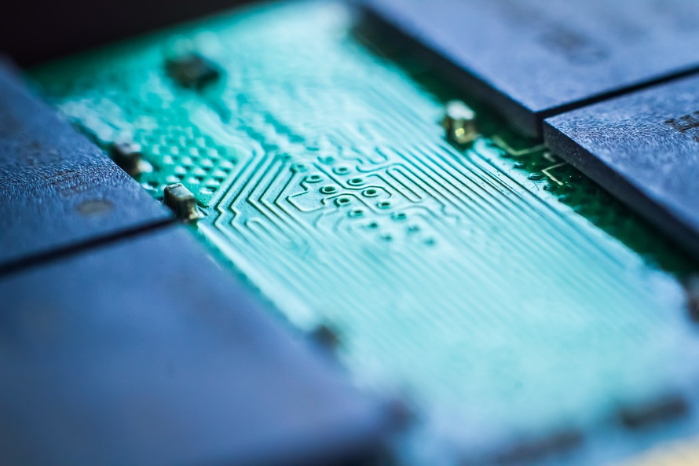
Strongbox secure

Slide 2
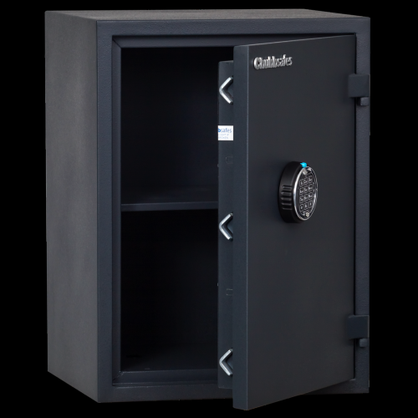
Problem to solve
For what? Securise your strongbox and avoid to be stolen
For who? Bank, Private seller, Conveyor, …
For where? House, Bank, Truck

Slide 3
Solution
Device functions & sensors…
Accelerometer to verify if there is an environment modification

Slide 4
Strategy
TAM (total addressable market): security
Money needs: 100€/units
Calendar (beta, deployment phase, …):
30/11/18-31/12/18: beta
01/01/19-01/03/18: deployment

Slide 5
شكرا
Aitäh
Děkuji
Obrigado
谢谢
Merci
Tack
Hvala
Gracias
Terima kasih
Thank you
Danke
ありがとう
Grazie
با تشکر از شما
Dankjewel
Dankie
고맙습니다
Tak
Nirringrazzjak
Kiitos
ขอบคุณ
Go raibh maith agat
Teşekkür ederim
iotagency@sigfox.com

